Slide 1
Active Learning (ML)
Akhilesh Ravi
Indian Institute of Technology Gandhinagar

Slide 2
What is active learning?
Let us say that you have some data.
You want to apply a machine learning technique to classify the data.
No labelled samples or a very small number of labelled samples, and a large amount of data.
Labelling each sample is expensive.
What will you do?

Slide 3
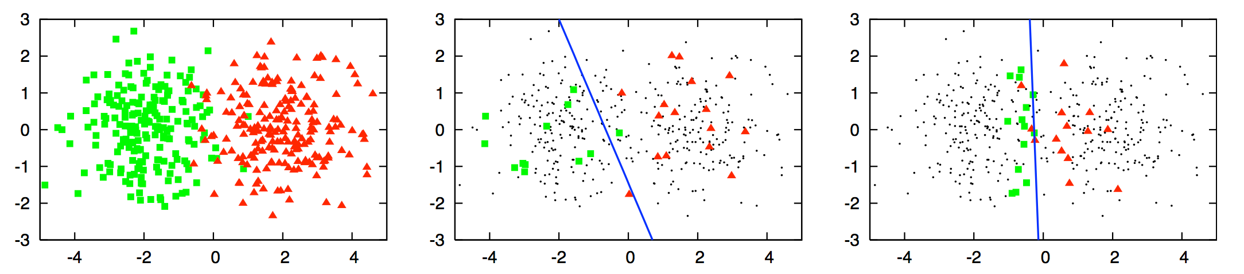
What is active learning?
Image Source: https://www.datacamp.com/community/tutorials/active-learning

Slide 4
What is active learning?

Slide 5
What is active learning?
“The key idea behind active learning is that a machine learning algorithm can perform better with less training if it is allowed to choose the data from which it learns.”^{[1]}
It gives the samples to be labelled in such a way that with less labelled samples, the machine learning model performs well - it chooses the optimal set of samples to be labelled for good performance
We could say that the model actively learns and sees what to learn next so that it can perform better.
References:
Settles, Burr. Active learning literature survey. University of Wisconsin-Madison Department of Computer Sciences, 2009.
"Active Learning (Machine Learning)". En.Wikipedia.Org, 2020, https://en.wikipedia.org/wiki/Active_learning_(machine_learning)#cite_note-settles-1. Accessed 31 Oct 2020.

Slide 6
Steps in Active Learning
Train the model on the labelled data.
Evaluate the model on all the unlabelled samples.
Based on the evaluation, choose the sample/list of samples to be labelled.
Label these samples and add them to the labelled data.
Repeat the above steps till a certain condition (stopping criterion)

Slide 7
An Important Component
Oracle - person or a model that knows the correct answer/classification/prediction to all questions/queries.^{[1][2]}
Practically, an expert in the corresponding field would be considered as an oracle.
Hosein, Stefan. "A Beginner's Guide To Active Learning". Datacamp Community, 2020, https://www.datacamp.com/community/tutorials/active-learning. Accessed 31 Oct 2020.
"Active Learning (Machine Learning)". En.Wikipedia.Org, 2020, https://en.wikipedia.org/wiki/Active_learning_(machine_learning)#cite_note-settles-1. Accessed 31 Oct 2020.

Slide 8
Active learning - Scenarios

Slide 9
Active Learning - Scenarios
Membership Query Synthesis
Pool-based Sampling
Stream-based Selective Sampling

Slide 10
Membership Query Synthesis
The learner has a distribution made from the original data.
The learner generates a sample from this distribution.
The oracle gives the prediction for the sample
This is added to the dataset that the learner uses for learning
References
Hosein, Stefan. "A Beginner's Guide To Active Learning". Datacamp Community, 2020, https://www.datacamp.com/community/tutorials/active-learning. Accessed 31 Oct 2020.
"Active Learning (Machine Learning)". En.Wikipedia.Org, 2020, https://en.wikipedia.org/wiki/Active_learning_(machine_learning)#cite_note-settles-1. Accessed 31 Oct 2020.

Slide 11
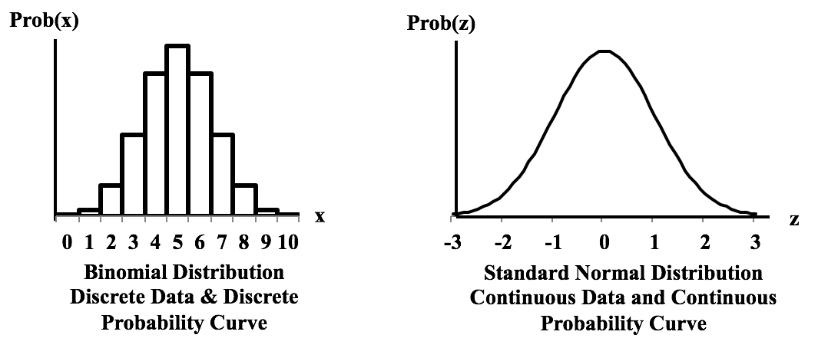
Membership Query Synthesis
Image Source: https://www.statisticsfromatoz.com/uploads/7/3/2/1/73216723/discrete-and-cont-distributions_orig.png

Slide 12
Pool-based Sampling
A data pool of unlabelled samples
Informativeness score - assigned to all the samples in the pool or a subset of pool if the pool is very large.
The most informative sample(s) is(are) selected.
Depending on the configuration ,one sample can be chosen each time or a few samples can be chosen each time.
These are labelled and added to the dataset that the learner uses for learning.
References
Hosein, Stefan. "A Beginner's Guide To Active Learning". Datacamp Community, 2020, https://www.datacamp.com/community/tutorials/active-learning. Accessed 31 Oct 2020.
"Active Learning (Machine Learning)". En.Wikipedia.Org, 2020, https://en.wikipedia.org/wiki/Active_learning_(machine_learning)#cite_note-settles-1. Accessed 31 Oct 2020.

Slide 13
Pool-based Sampling
Image Source: https://www.datacamp.com/community/tutorials/active-learning

Slide 14
Stream-based Selective Sampling
Stream-based Selective Sampling
Assumption: Getting an unlabelled sample is free
The samples are taken one by one and examined
Based on an informativeness score for each sample, decide whether an instance has to be labelled in this iteration or not.
Many iterations
References
Hosein, Stefan. "A Beginner's Guide To Active Learning". Datacamp Community, 2020, https://www.datacamp.com/community/tutorials/active-learning. Accessed 31 Oct 2020.
"Active Learning (Machine Learning)". En.Wikipedia.Org, 2020, https://en.wikipedia.org/wiki/Active_learning_(machine_learning)#cite_note-settles-1. Accessed 31 Oct 2020.

Slide 15
Query Strategies

Slide 16
Query Strategies
There are many query strategies.^{[1][2]} Here are three common strategies:
Least Confidence
Margin Sampling
Entropy Sampling
Hosein, Stefan. "A Beginner's Guide To Active Learning". Datacamp Community, 2020, https://www.datacamp.com/community/tutorials/active-learning. Accessed 31 Oct 2020.
"Active Learning (Machine Learning)". En.Wikipedia.Org, 2020, https://en.wikipedia.org/wiki/Active_learning_(machine_learning)#cite_note-settles-1. Accessed 31 Oct 2020.

Slide 17
Query Strategies - Least Confidence
The sample which has the least probability for its most likely label is chosen.
Eg - Let the samples in a dataset be in three classes - A, B, C.
Sample S₁ probabilities: A - 0.5, B - 0.25, C - 0.25 Most likely label: A (0.5)
Sample S₂ probabilities: A - 0.1, B - 0.8, C - 0.1 Most likely label: B (0.8)
Here, S₁ will be chosen according to the above query strategy.
References
Hosein, Stefan. "A Beginner's Guide To Active Learning". Datacamp Community, 2020, https://www.datacamp.com/community/tutorials/active-learning. Accessed 31 Oct 2020.
"Active Learning (Machine Learning)". En.Wikipedia.Org, 2020, https://en.wikipedia.org/wiki/Active_learning_(machine_learning)#cite_note-settles-1. Accessed 31 Oct 2020.

Slide 18
Query Strategies - Margin Sampling
The problem with LC is that is takes only the most likely label into account. Thus, this query strategy takes the sample which has least difference between its most likely label and second most likely label probabilities.
Eg - Let the samples in a dataset be in three classes - A, B, C.
Sample S₁ probabilities: A - 0.5, B - 0.45, C - 0.05 0.5 - 0.45 = 0.05
Sample S₂ probabilities: A - 0.3, B - 0.4, C - 0.3 0.4 - 0.3 = 0.1
Here, S₁ will be chosen according to the margin sample.
According to LC, S₂ will be chosen.
References
Hosein, Stefan. "A Beginner's Guide To Active Learning". Datacamp Community, 2020, https://www.datacamp.com/community/tutorials/active-learning. Accessed 31 Oct 2020.
"Active Learning (Machine Learning)". En.Wikipedia.Org, 2020, https://en.wikipedia.org/wiki/Active_learning_(machine_learning)#cite_note-settles-1. Accessed 31 Oct 2020.

Slide 19
Query Strategies - Entropy Sampling
LC takes only most likely label into account and margin sampling sampling takes the top two likely labels into account. Entropy sampling uses the probability of all possible labels. This is done using the metric called entropy. The sample with the largest entropy is selected.
References
Hosein, Stefan. "A Beginner's Guide To Active Learning". Datacamp Community, 2020, https://www.datacamp.com/community/tutorials/active-learning. Accessed 31 Oct 2020.
"Active Learning (Machine Learning)". En.Wikipedia.Org, 2020, https://en.wikipedia.org/wiki/Active_learning_(machine_learning)#cite_note-settles-1. Accessed 31 Oct 2020.

Slide 20
Looking back: Steps in Active Learning
Train the model on the labelled data.
Evaluate the model on all the unlabelled samples.
Based on the evaluation, choose the sample/list of samples to be labelled.
Label these samples and add them to the labelled data.
Repeat the above steps till a certain condition (stopping criterion)
Image Source: https://www.datacamp.com/community/tutorials/active-learning

Slide 21
Advantages of Active Learning
Eases the problem of lack of labelled data; only a fraction of the data has to be labelled
Can be applied for online learning scenarios - many practical scenarios in industries involve online learning

Slide 22
Application Areas of Active Learning
Natural Language Processing^{[1]}
Lots of data to label
Reinforcement Learning
Online Learning
Lot of data coming in continuously
Spam filters, ranking of search results, job listings, etc.^{[2]}
References
Hosein, Stefan. "A Beginner's Guide To Active Learning". Datacamp Community, 2020, https://www.datacamp.com/community/tutorials/active-learning. Accessed 31 Oct 2020.
https://www.oreilly.com/content/real-world-active-learning/

Slide 23
Active learning - Visualizations

Slide 24
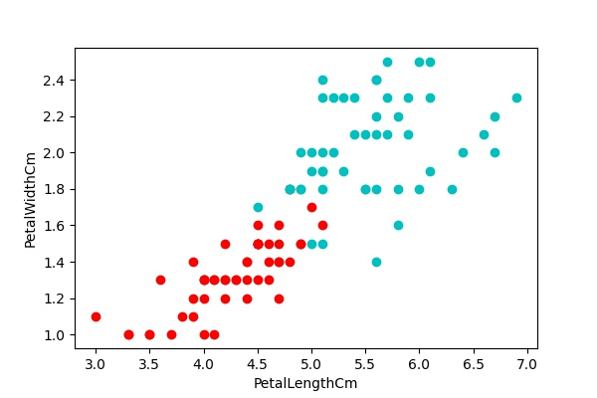
Active Learning - Visualizations
Iris Dataset
Versicolor - red
Virginica -
cyan/light blue
Source: https://www.kaggle.com/uciml/iris

Slide 25
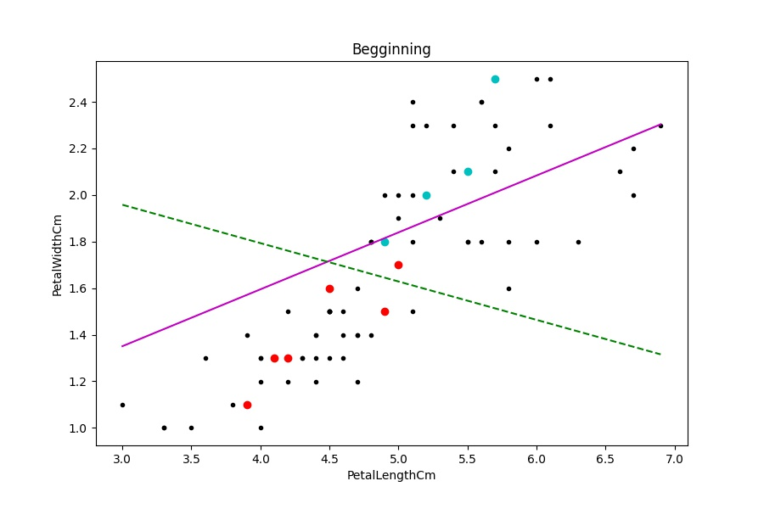
Active Learning - Visualizations

Slide 26
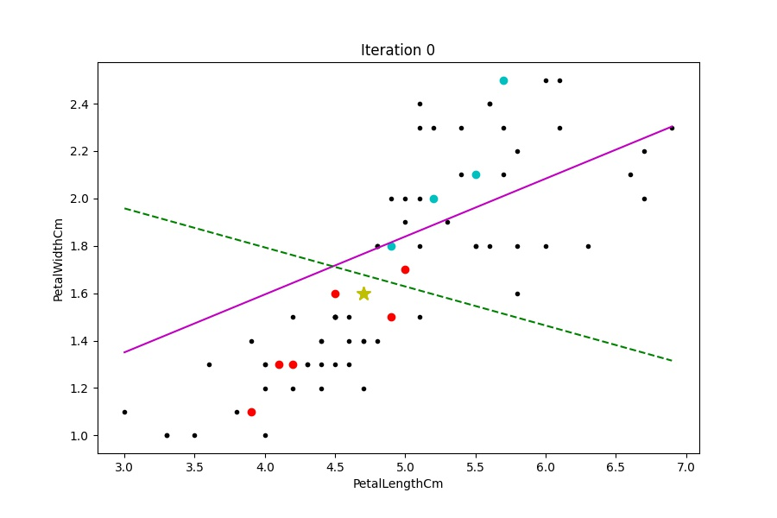
Active Learning - Visualizations

Slide 27
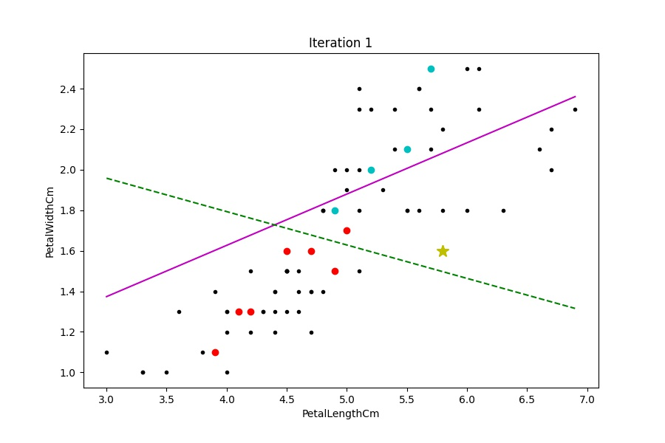
Active Learning - Visualizations

Slide 28
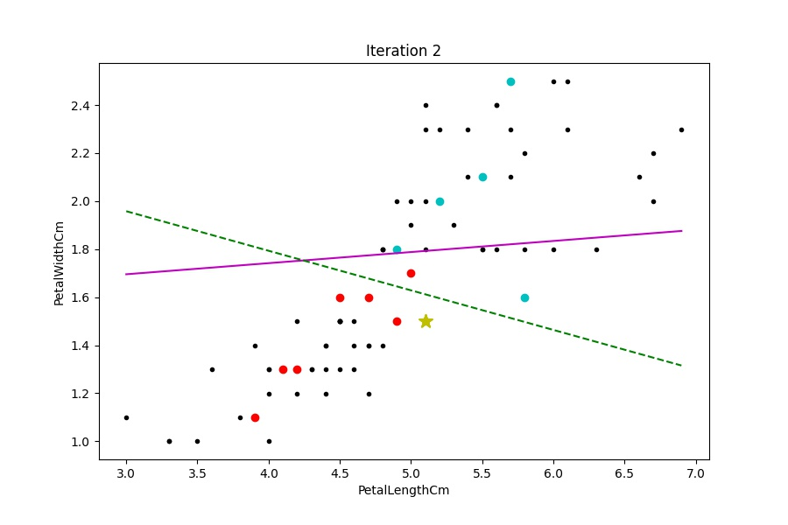
Active Learning - Visualizations

Slide 29
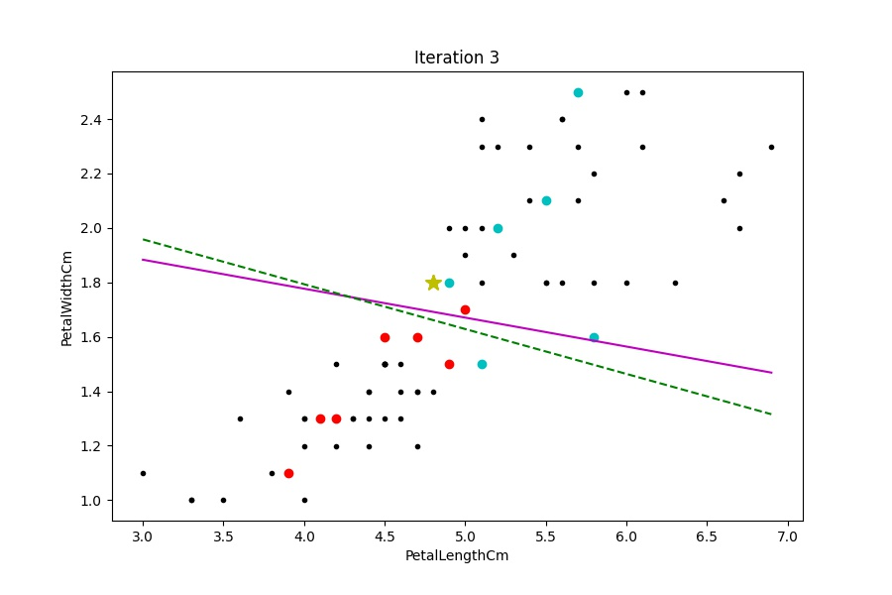
Active Learning - Visualizations

Slide 30
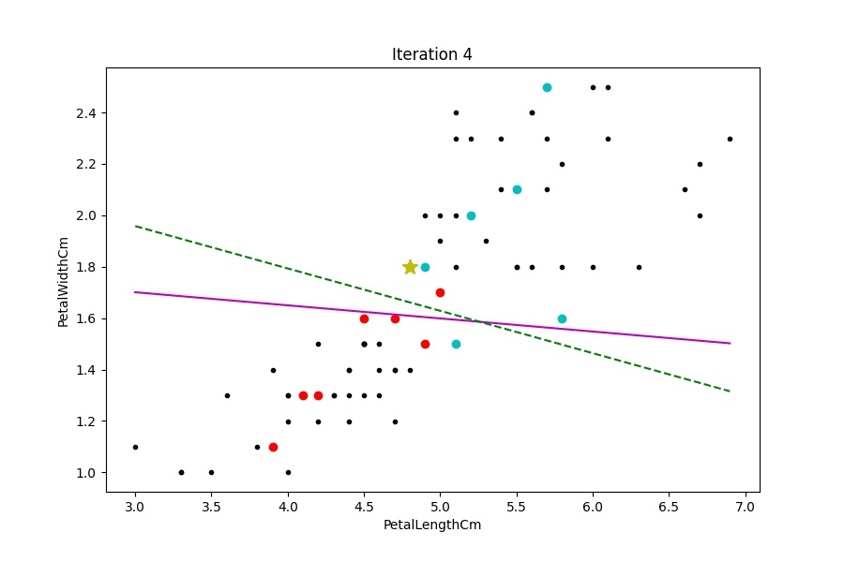
Active Learning - Visualizations

Slide 31

Active Learning - Visualizations

Slide 32
Active Learning - Visualizations

Slide 33


Tutorial on Active Learning
Active Learning Tutorial - bit.ly/medium-active-learning
Images
Towards Data Science Logo - https://miro.medium.com/max/1200/1*F0LADxTtsKOgmPa-_7iUEQ.jpeg
Medium.com Logo - https://miro.medium.com/max/8978/1*s986xIGqhfsN8U--09_AdA.png

Slide 34
References
Datacamp.org - https://www.datacamp.com/community/tutorials/active-learning
Wikipedia.org - https://en.wikipedia.org/wiki/Active_learning_(machine_learning)

Slide 35
Thank you

